Slide 1
Tutorial 1 (Part 2)
Information and Retrieval Systems
10/15/2020

Slide 2
Topics to be covered
Tokenization
N-gram

Slide 3
Tokenization
Tokenization is a way of separating a piece of text into smaller units called tokens.
Here, tokens can be either words, characters, or subwords.
Hence, tokenization can be broadly classified into 3 types
Word
Character
Subword (n-gram characters) tokenization.

Slide 4
Word Tokenization
The most common way of forming tokens is based on space.
Like for the sentence “Never give up” and assuming space as a delimiter, the tokenization of the sentence results in 3 tokens
“Never”
“give”
“up”
As each token is a word, it becomes an example of Word tokenization.

Slide 5
Character & Subword tokenization
Similarly, tokens can be either characters or subwords.
For example, let us consider “smarter”:
Character tokens: s-m-a-r-t-e-r
Subword tokens: smart-er

Slide 6
Reasons behind Tokenization
As tokens are the building blocks of Natural Language, the most common way of processing the raw text happens at the token level.
The most popular deep learning architectures for NLP like RNN (Recurrent neural network) , GRU (Gated recurrent Unit), and LSTM (Long short-term memory) also process the raw text at the token level.

Slide 7
Contd.
As shown here, RNN receives and processes each token at a particular timestep.

Slide 8
N-gram
N-grams of texts are extensively used in text mining and natural language processing tasks.
N-grams are basically a set of co-occurring words within a given window and when computing the n-grams you typically move one word forward (although you can move X words forward in more advanced scenarios).
N-grams = consecutive sequences of tokens

Slide 9
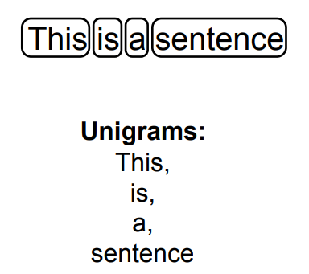
Unigram (N=1)

Slide 10
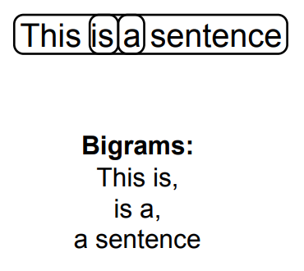
Bigrams (N=2)

Slide 11
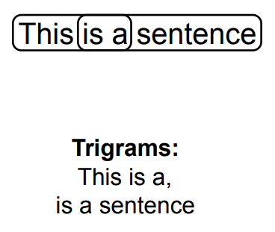
Trigrams (N=3)

Slide 12
Use of N-grams
Speech recognition
Handwriting recognition
Predictive text input
Statistical machine translation

